Slide 1
Day 11
JS and jQuery Jubilee
February 16, 2017
Notes:
<number>

Slide 2
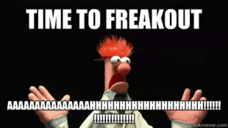
This shouldn’t be you…
Notes:
<number>

Slide 3
Remember this!
“You can’t tell whether you’re learning something when you’re learning it—in fact, learning feels a lot more like frustration.”
“What I’ve learned is that during this period of frustration is actually when people improve the most, and their improvements are usually obvious to an outsider. If you feel frustrated while trying to understand new concepts, try to remember that it might not feel like it, but you’re probably rapidly expanding your knowledge.”
Jeff Dickey, Author of Write Modern Web Apps with the MEAN Stack: Mongo, Express, AngularJS, and Node.JS
Notes:
<number>

Slide 4

Feedback #1 – Pace is Fast!!!
That said, as instructors / TAs we are here to help.
As we fall into a class rhythm, feel encouraged to schedule a 1-1 during office hours.
In addition to using the time to understand concepts… it’s a great way for us to identify weaknesses and outline steps to get on the right track.
These might be before / after class.
Notes:
<number>

Slide 5
Today’s Class
Notes:
<number>

Slide 6
Objectives
Play Captain Planet: The GAME!
Practice jQuery on Fridge
Pretend to learn scoping
Understand click events
Notes:
<number>

Slide 7
Captain Planet!
Notes:
<number>

Slide 8
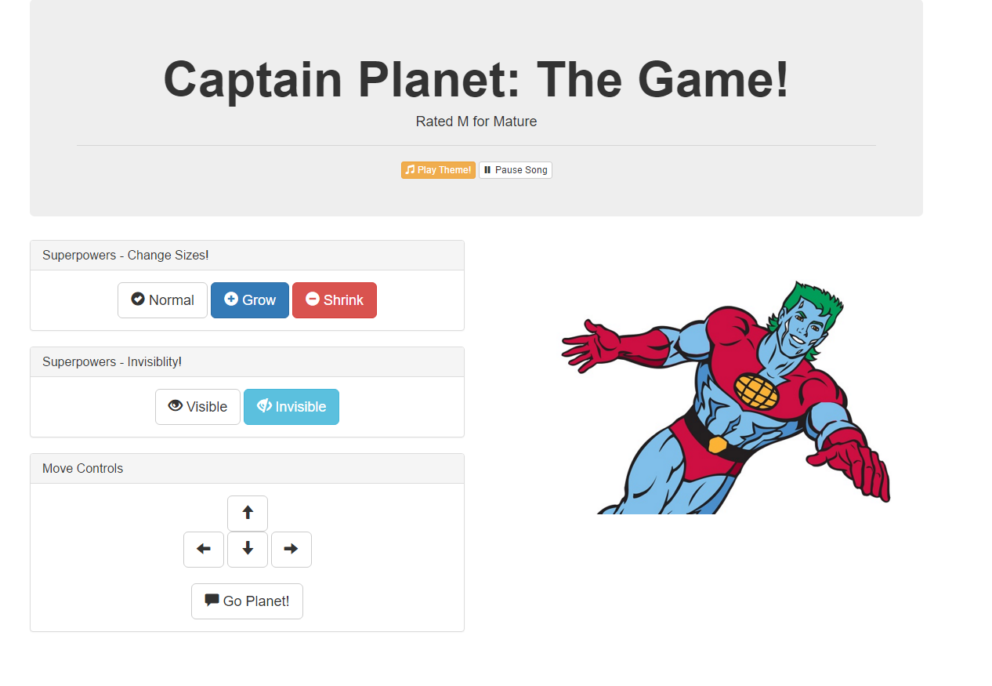
Notes:
<number>

Slide 9
Demo Time
Instructor: Demo
(CaptainPlanet.html | 1-CaptainPlanet)
Notes:
<number>

Slide 10
> YOUR TURN!!
Activity: 1-CaptainPlanet | Suggested Time: 7min
Code Dissection:
Examine the code for the Captain Planet Game
Then, in groups, describe how this code works in 5 Steps.
1.
2.
3.
4.
5.
Notes:
<number>

Slide 11
Pseudocoding – Captain Planet
Solution:
An initial HTML Layout was created using Bootstrap.
A reference to jQuery was added.
Key buttons and images were assigned unique class names
jQuery was used to capture when the corresponding buttons were clicked. This was done through the $( ) identifier with the class-name inside.
Code was created that changed the css of target classes in response to the click events.
Notes:
<number>

Slide 12
> YOUR TURN!!
Activity: 1-CaptainPlanet | Suggested Time: 12 min
Look at the jQuery API Docs and add a button of your own that gives Captain Planet a new power.
Examples:
Click to… stretch Captain Planet
Click to… trigger a maniacal laugh
Click to… create clones of Captain Planet
Click to… create a shield (hint: border)
Click to… create fire or water (hint: images)
Slack out a screenshot of the working example
Notes:
<number>

Slide 13
jQuery Recap
Notes:
<number>

Slide 14

jQuery – In a Nutshell
Find some HTML.
Attach to an event.
Do something in response.
Notes:
<number>

Slide 15
jQuery – In a Nutshell
We use the jQuery $( ) identifier to capture HTML elements.
$(“.classname”)
$(“elementname”)
$(“#idname”)
$(“etc”)
Then we tie the element to a jQuery method of our choosing to capture events and change that element (or a different element)
.on(“click”)
.ready( )
Finally, we tie the element to a jQuery method of our choosing to capture events and change that element (or a different element)
.append( )
.animate( )
.etc()
Notes:
<number>

Slide 16
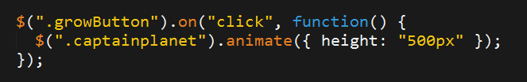
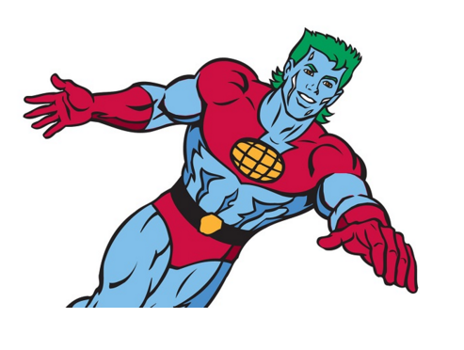
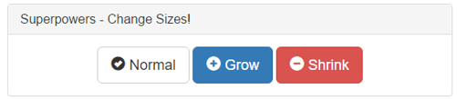
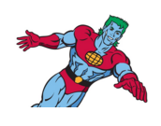
jQuery – Common Example
1. Click the Grow Button
2. Make Captain Planet Grow
Notes:
<number>

Slide 17
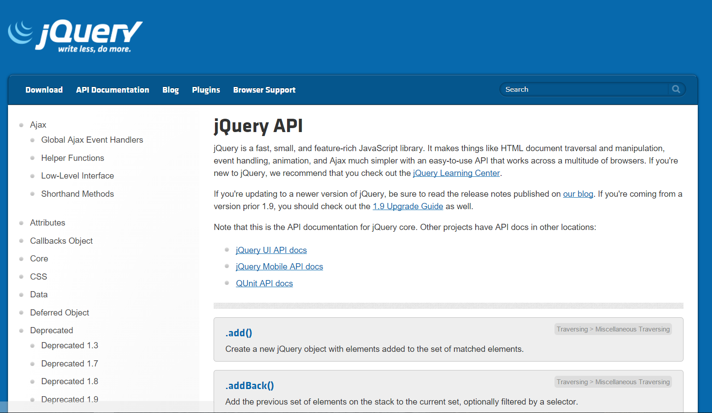
Use Documentation When Needed!
Notes:
<number>

Slide 18
Fridge Game!
Notes:
<number>

Slide 19
> YOUR TURN!!
Activity: 2-FridgeGame | Suggested Time: 35 min
Working in groups of 3 complete the code for the fridge activity such that:
Javascript dynamically generates buttons for each of the letters on the screen.
Clicking any of the buttons leads the SAME letter to be displayed on the screen.
Hitting the clear button erases all of the letters from the fridge.
Note: This is a challenging exercise. You may want one person to type, while the other two watch over to catch bugs and/or research necessary snippets.
Notes:
<number>

Slide 20
Crystal Collector!
Notes:
<number>

Slide 21
Demo Time
Instructor: Demo
(1-12.html | 3-CrystalExample)
Notes:
<number>

Slide 22
Lexical Scope
Notes:
<number>

Slide 23

Shh… Just Between Us.
WARNING:
This next section is heavy on theory.
Disclaimer:
It’s not the end of the world if its confusing and/or you’re completely lost.
Notes:
<number>

Slide 24
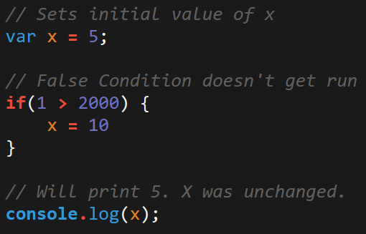
Javascript Scope
In Javascript curly brackets { } indicate blocks of code.
In order for the code inside the curly brackets to be executed, it must meet the condition or it must be called (example: functions).
These blocks of code have the power to affect variables outside the curly brackets if those variables were declared outside – so be careful!
Notes:
<number>

Slide 25
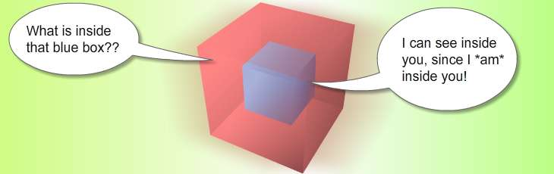
Scope = Boxes in Boxes
Scope impacts which variables can be accessed by which function.
Notes:
<number>

Slide 26
Scope = Boxes in Boxes
function global()
function inner()
function eveninner()
function innest()
Notes:
<number>

Slide 27
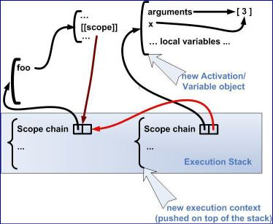
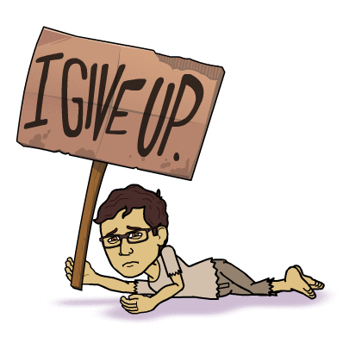
Javascript’s Odd Relationship with Scope
For those who have programmed in other languages, Javascript seemingly behaves in unpredictable ways.
Notes:
<number>

Slide 28
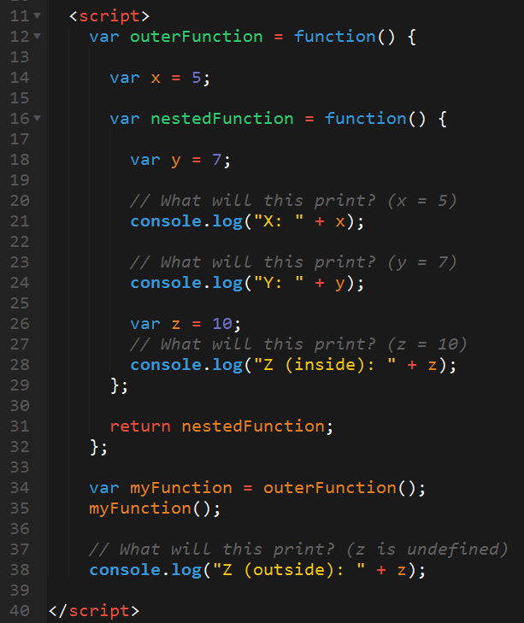
Javascript Scope Example (Tricky)
Here nested function is clearly able to access the variables of their parent function.
Whereas outer function has no idea what the variable z is because it was declared in a child function.
Notes:
<number>

Slide 29
> YOUR TURN!!
Activity: 4-ScopeOne | Suggested Time: 5 min
Take a few moments dissecting what I just said.
Look at the file sent to you and explain to the person next to you what is meant by:
The terms parent function and child function
The concept that child functions can access parent variables but not vice versa.
Be prepared to share!
Notes:
<number>

Slide 30
> YOUR TURN!!
Activity: 5-ScopeTwo | Suggested Time: 7 min
Take a few moments to dissect the code just sent to you.
Try to predict what will be printed in each of the examples.
Be prepared to share!
Note: Pay attention to the unusual use of the keyword: ‘this”
Notes:
<number>

Slide 31
> YOUR TURN!!
Activity: 6-ScopeThree | Suggested Time: 7 min
Take a few moments to dissect the code just sent to you.
Try to predict what will be printed in each of the examples.
Be prepared to share!
Note: Pay attention to the unusual use of the keyword: ‘this”
Notes:
<number>

Slide 32
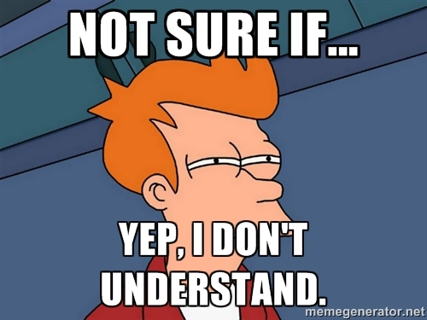
You Probably…
Notes:
<number>

Slide 33
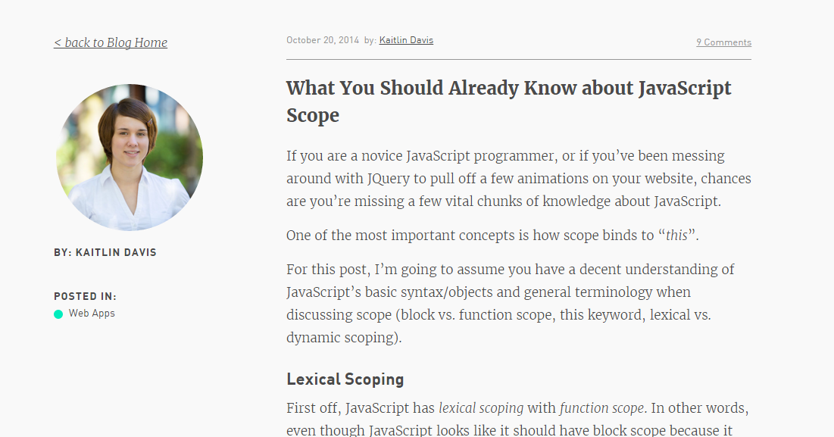
Helpful Article (If you’d like to learn more…)
Notes:
<number>

Slide 34
Build a Brain Teaser
(Time Permitting)
Notes:
<number>

Slide 35
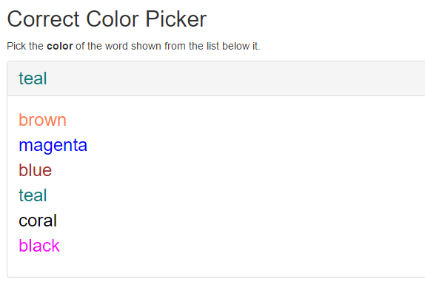
Color Picker – Brain Teaser
Notes:
<number>

Slide 36
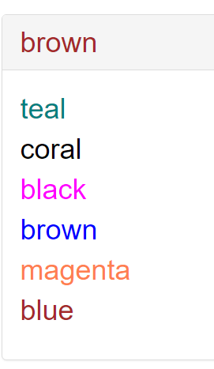
> YOUR TURN!!
Activity: 7-ColorCorrector | Suggested Time: 20 min
Using the files sent to you as a starting point, add the missing code such that the Color Corrector game works correctly.
To win, you should be picking the “word” that matches the color of the text at the top.
Ex:
Notes:
<number>

Slide 37
Questions
Notes:
<number>

